Slide 1
SUPER RESOLUTION using DEEP LEARNING with NEURAL ARCHITECTURE SEARCH (NAS) and HYPER PARAMETER TUNING
Muhammad Fazil K
CS20B1012, IIITDM Kancheepuram

Slide 2
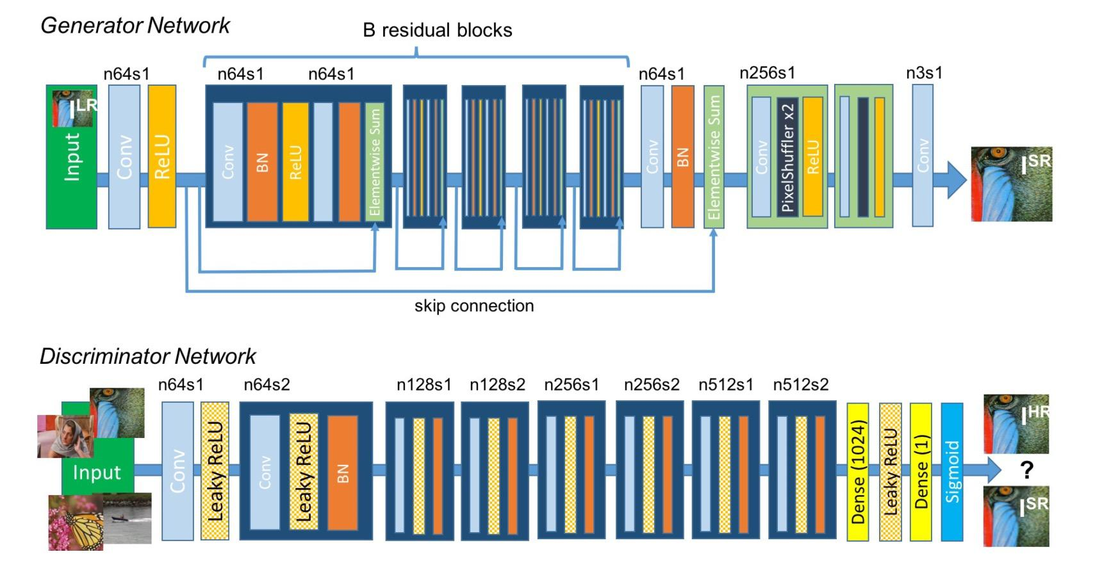
Introduction
The project aims to utilize Neural Architecture Search & Hyper Parameter Optimization to train the best model possible for the Super Resolution task.
I opted for Generative Adversarial Network for the task

Slide 3
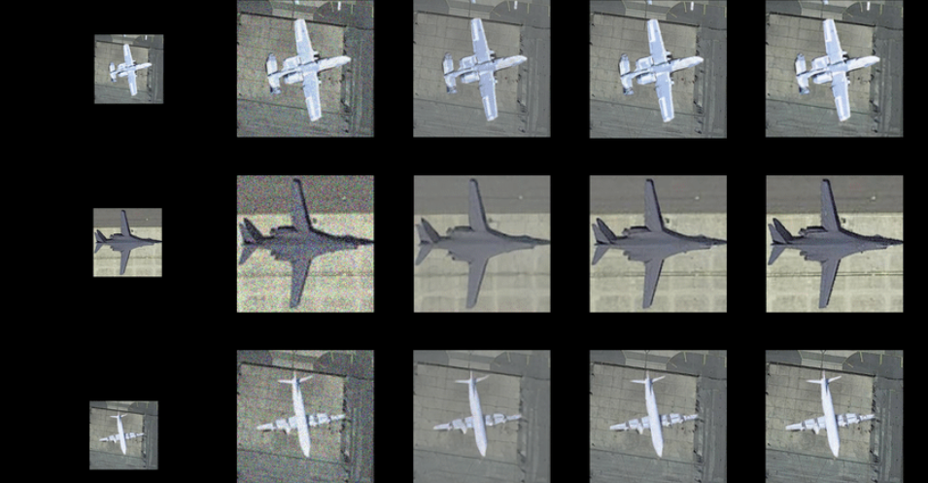
Methodology - Overview
Collection and Preparation of data, Including augmentation , downsampling and test-train-valid split
Choosing the model GAN out of the competitors such as SRCNN, ESPCN etc.
Neural Architecture Search
Hyper Parameter Optimization
Training
Validation
Testing
BICUBIC
SRCNN
SRGAN

Slide 4
Neural Architecture Search
Chose Microsoft toolkit NNI for NAS and HPT
Search Space Parameters : No. of generator blocks, No. of discriminator blocks, conv_kernel_size, generator depth, discriminator depth, generator activation & discriminator activation
Chose PSNR as the evaluation metric
The ideal Value of PSNR is in between 20~50
NAS could find the best architecture with PSNR value of 19.74 with the following configuration : {8, 4, 3, 128, 128, PRelu, LeakyRelu}
The smaller value is due to the low sample dataset size and small no. of epochs

Slide 5
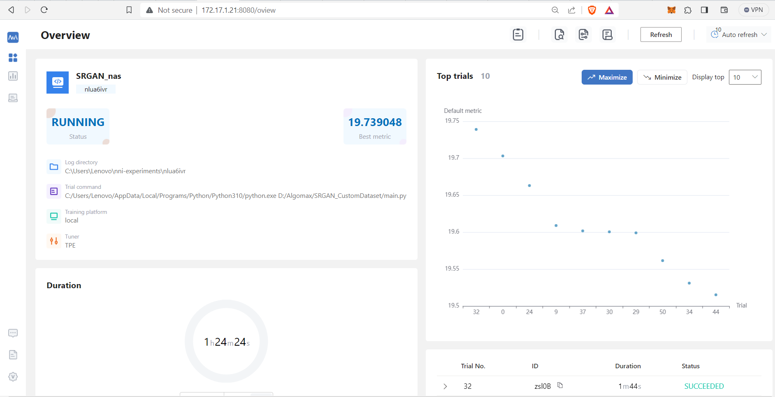
NAS Environment in NNI GUI

Slide 6
Hyper Parameter Tuning
Similar to NAS, I used NNI to conduct HPT on a small sample dataset and compared the configurations based on PSNR value
Parameters in the search space were Batch Size, Learning Rate and No, of epochs
Due to sufficient no, of epochs, this could produce a peak PSNR of 22.966
The ideal range of PSNR was excited when
Batch size == 8
Epochs == 4000
LR =~ 0.0008

Slide 7
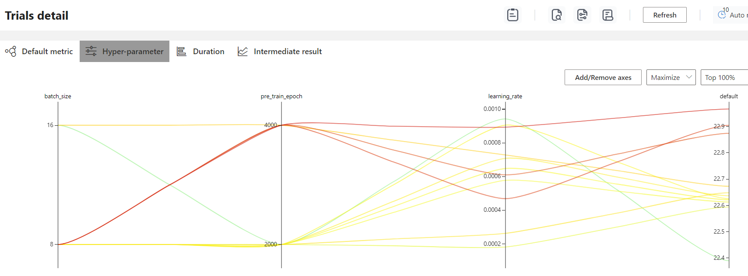
Influence of Hyper Parameters

Slide 8
Training Phase
Configured the architecture and hyper parameters leveraging the results from NAS and HPT
{No. of generator blocks, No. of discriminator blocks, conv_kernel_size, generator depth, discriminator depth, generator activation & discriminator activation} = {8, 4, 3, 128, 128, PRelu, LeakyRelu}
{Batch Size, Learning Rate and No, of epochs} = {8, 1e-4, 4000}
The models were saved at a regular interval of 100 epochs

Slide 9
Evaluation
The validation of various saved models yielded PSNR values in the range of 24-26 , which emphasizes the process was indeed successful
Best results were followed produced by the following models
Model-Epochs | Average PSNR | Peak PSNR
2700 | 25.393 | 37.936
2100 | 25.320 | 40.316
3400 | 25.291 | 38.040
1500 | 25.250 | 40.786

Slide 10
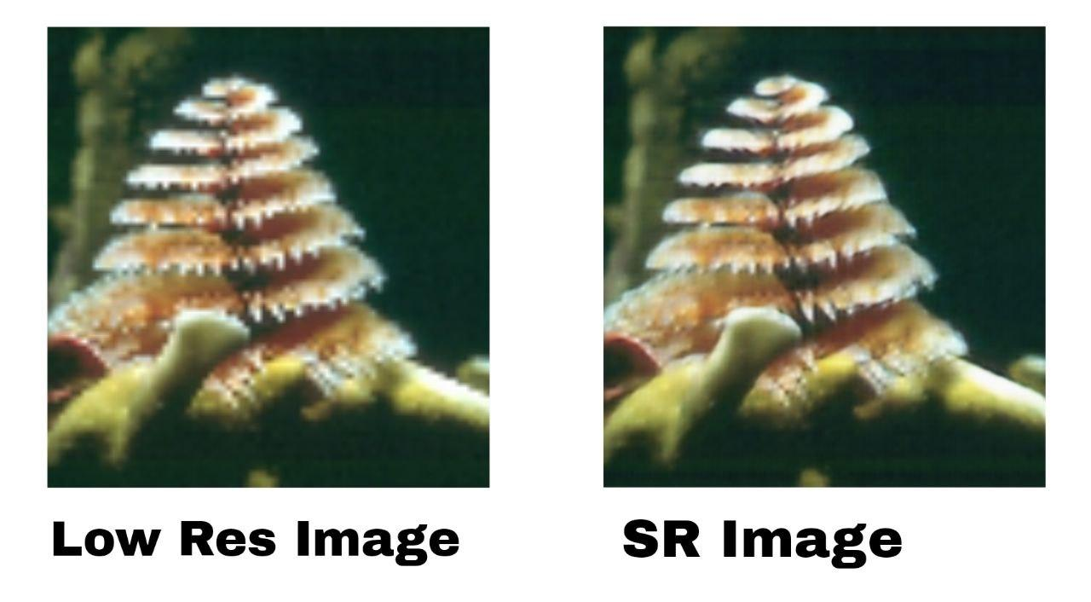
Testing Results
← Upscaled by the best model (2700) resulted by the experiment
Even though it can not achieve the Ground Truth, still it upscales the images upto a satisfying level

Slide 11
Results Summary
NAS using 7 parameters and a search space of size 64 , PSNR of : 19.74
The lower value later proven to be due to the low number of epochs
HPT using 3 parameters and a search space of 8 , PSNR = 22.97
Finally Training & Validation, PSNR = 25.39
Model Produced decent results

Slide 12
Key Insights
GAN’s efficiency for the SR task played a key role in the success
Generator Activation Function (PRelu) and the network depths are the key players in deciding the quality of the model (Specific to my search space)
Even Though the NAS could not achieve ideal range of PSNR, it could provide the best architecture which later achieved it
4000 epochs were seemed to be necessary during HPT phase, but later the sufficient dataset size led to convergence considerably faster

Slide 13
Improvements I could have made
Making the dataset larger, using more augmentation technique etc. can lead to better result
Expanding the search space (as suggested in the report) can get us the pest possible architecture and hyper parameters compared to the current local minimas
Longer training periods for HPT with additional parameters

Slide 14
Acknowledgments
[1609.04802] Photo-Realistic Single Image Super-Resolution Using a Generative Adversarial Network
GitHub - microsoft/nni: An open source AutoML toolkit for automate machine learning lifecycle, including feature engineering, neural architecture search, model compression and hyper-parameter tuning.
Learn how to train SRGAN on Custom dataset
Deep Learning for Image Super-Resolution [incl. Architectures]

